Slide 1
26.4 Nineteenth Century Progress
The Industrial Revolution happened because of the inventions such as the spinning jenny and the steam engine. By the late 1800s, advances in both industry and technology were occurring faster than ever before. In turn, the demands of growing industries spurred even greater advances in technology. A surge of scientific discovery pushed frontiers of knowledge forward. At the same time, in industrialized countries, economic growth produced many social changes.

Slide 2
Thomas Edison
Patented more than 1,000 inventions
Inventions:
Research laboratory is probably his most important invention.
Phonograph
Lightbulb
Kinetoscope (for motion pictures)

Slide 3
Alexander Graham Bell
Was a teacher of deaf students.
He invented the telephone in his spare time.
Displayed the device at the Philadelphia Centennial Exposition of 1876.

Slide 4
Guglielmo Marconi
Used theoretical discoveries about electromagnetic waves to create the first radio in 1895.
It initially sent messages using Morse Code through the air without the use of wires. Early radios were quickly used by ships at sea.

Slide 5
Henry Ford
Automobiles were already invented in Germany using the gasoline engine.
Ford made the car affordable by using standardized interchangeable parts and manufacturing them on an assembly line.
Price of Model T Ford eventually dropped to $300.

Slide 6
Wilbur and Orville Wright
Both were bicycle mechanics from Dayton, Ohio.
They solved the age-old riddle of flight.
December 17, 1903, they few a gasoline-powered flying machine at Kitty Hawk, North Carolina
The longest flight only lasted 59 seconds.
Wilbur
Orville

Slide 7
Louis Pasteur
Discovered that the fermentation process of alcohol was caused by microscopic organisms he called bacteria.
He developed pasteurization or heating to kill germs in liquids such as milk.

Slide 8
Joseph Lister
Having read Pasteur’s work, he concluded that germs might explain why patients die of infection after surgery.
He began using antiseptics to sterilize wounds and surgical instruments.

Slide 9
Charles Darwin
Developed the evolutionary theory of natural selection which challenged the idea of creation.
He used this theory to explain the variety in plant and animal species.
His book is titled On the Origin of the Species by Means of Natural Selection.

Slide 10
Gregor Mendel
Austrian monk who discovered that there is a pattern to the way that certain traits are inherited.
He began the science of genetics.

Slide 11
John Dalton
Theorized that all matter is made of tiny particles called atoms.
Showed elements contain only one kind of atom, which has a specific weight.
Compounds have more than one kind of atom.

Slide 12
Dmitri Mendelev
Organized a chart on which all the known elements were arranged in order of weight.
Today it is called the Periodic Table of Elements.

Slide 13
Marie and Pierre Curie
This husband and wife team discovered radium and polonium. These elements released energy which Marie Curie named “radioactivity.”
The Curies shared the Nobel Prize for chemistry in 1903.
Pierre Currie died when hit by a horse drawn vehicle in 1906.
Marie Curie won the Nobel Prize again in 1911.
She died in 1936 from the effects of working with radiation without safety precautions. She is known to have carried radioactive isotopes in her pockets, and stored them in her desk drawers. It was unknown at the time that radiation had such negative health effects.

Slide 14
Ernest Rutherford
Rutherford suggested that atoms were made up of yet smaller particles.
Each atom, he said, had a nucleus surrounded by one or more particles called electrons.

Slide 15
Ivan Pavlov
Russian physiologist who believed that human actions were often unconscious reactions to experiences and could be changed by training.
He experimented with dogs getting them to salivate at the ringing of a bell. This is called “conditioning.”

Slide 16
Sigmund Freud
A pioneer in psychology.
Freud believed that the unconscious mind drives how people think and act.
He founded a type of therapy called psychoanalysis.

Slide 17
Mass Culture—sometimes called “popular culture” or “pop culture”
“A set of cultural values and ideas that arise from common exposure of a population to the same cultural activities, communications media, music and art, etc. Mass culture becomes possible only with modern communications and electronic media. A mass culture is transmitted to individuals, rather than arising from people's daily interactions, and therefore lacks the distinctive content of cultures rooted in community and region. Mass culture tends to reproduce the liberal value of individualism and to foster a view of the citizen as consumer.”
Retrieved from Online Dictionary of the Social Studies on April 6, 2011, http://bitbucket.icaap.org/dict.pl?term=MASS%20CULTURE

Slide 18
Vaudeville
Vaudeville was a theatrical genre of variety entertainment in the United States and Canada from the early 1880s until the early 1930s. Each performance was made up of a series of separate, unrelated acts grouped together on a common bill. Types of acts included popular and classical musicians, dancers, comedians, trained animals, magicians, female and male impersonators, acrobats, illustrated songs, jugglers, one-act plays or scenes from plays, athletes, lecturing celebrities, minstrels, and movies.

Slide 19
Rialto Square Theater, Joliet, Illinois
The Rialto Square Theater in Joliet, Illinois.

Slide 20
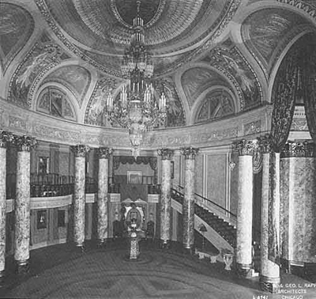
Rialto’s rotunda

Slide 21
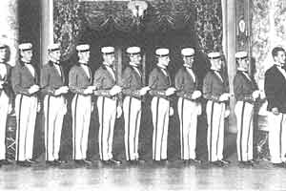
Rialto ushers, circa 1926

Slide 22
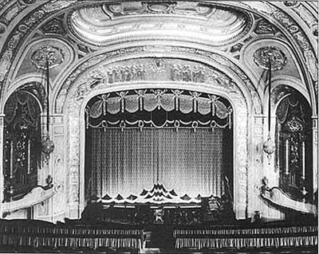

Slide 23
Orpheum Theater, Tulsa, OK

Slide 25
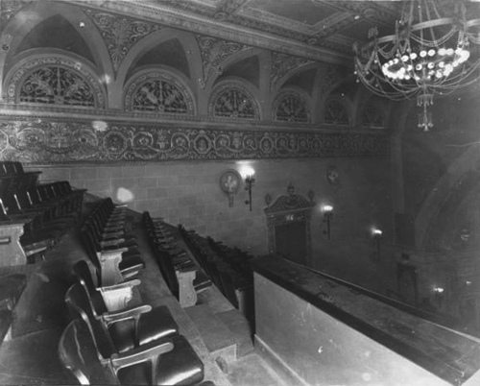

Slide 26
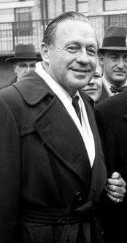
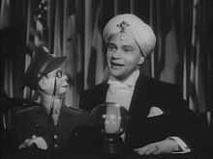
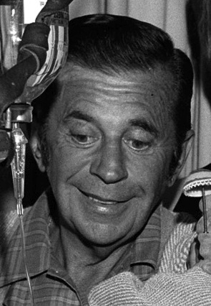
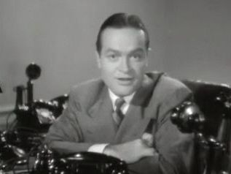
Examples of well-known Vaudeville acts
Abbott and Costello (comedians)
Morey Amsterdam (cello playing and comedy)
Jack Benny (comedian)
Edgar Bergen (ventriloquist) and Charlie McCarthy (the dummy)
Bob Hope (comedian/actor)

Slide 27
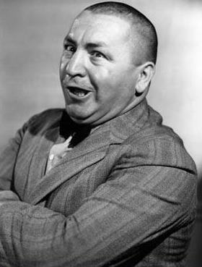
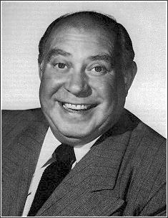
The Three Stooges
Better known for their film shorts, The Three Stooges got their start on the Vaudeville circuit, employed by Ted Healy. They were then called Ted Healy and his Stooges. The original three were Moe, Larry, and Shemp who appeared in the film Soup to Nuts in 1930 (above right). Shemp left the act in 1932 to be replaced by Jerome “Curly” Howard because of disagreements with Healy. They eventually separated from Healy’s act. When Curly’s stroke forced him into retirement in 1946, Shemp returned to the act until his death in 1955. Joe Besser replaced Shemp.
Original Three:
Shemp, Moe, Larry
in Soup to Nuts
Joe Besser
Jerome “Curly” Howard

Slide 28
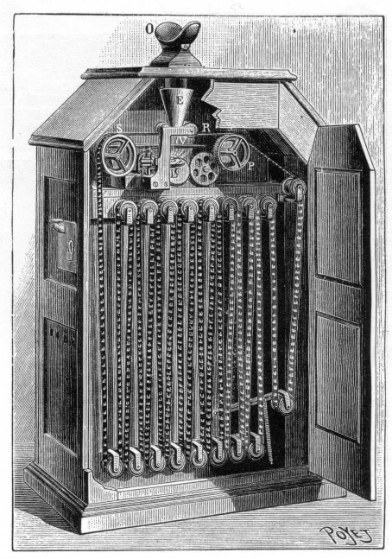
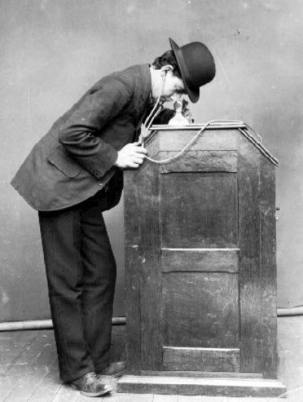
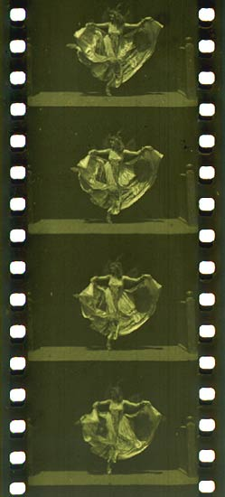
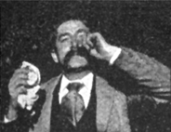
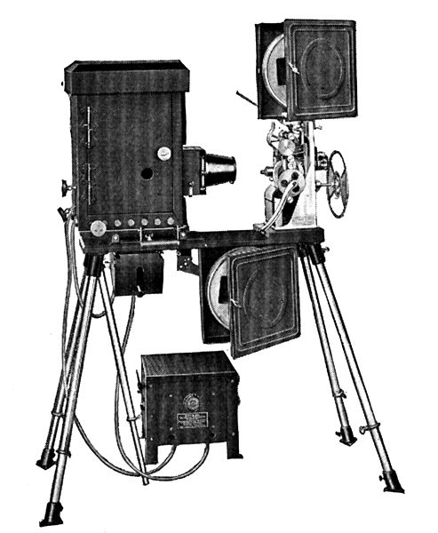
Movies
Original kinetospoce with the viewer at the top
Projecting Kinetoscope, circa 1914
Fred Ott’s Sneeze a five –second film (1894), and the first for which Edison received a copyright.
35 mm filmstrip of the Edison production Butterfly Dance (ca. 1894–95), featuring Annabelle Whitford Moore, in the format that would become standard for both still and motion picture photography around the world.

Slide 29
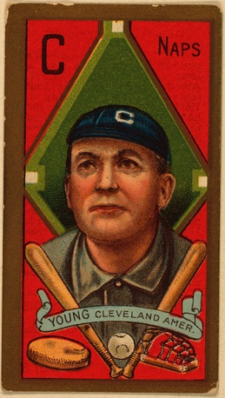
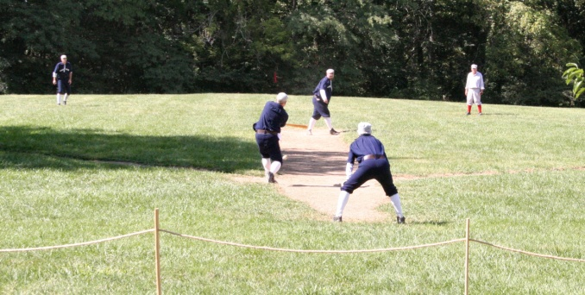
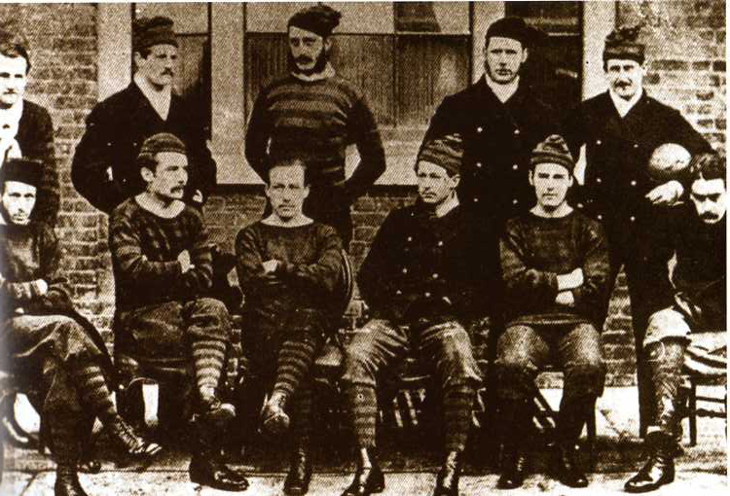
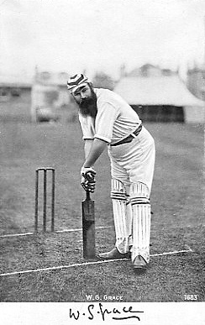
Spectator Sports/Olympics
United States
Professional football and baseball
Europe
Professional soccer
Professional cricket
Spreads to Australia, India, and South Africa
International Olympic Games began in 1896
Re-enactment of an 1886 baseball game.
Cy Young baseball card, circa 1911
Royal Engineers in 1872 (Association Football in the UK)
English Cricketter, W.G. Grace in 1883.

